Slide 1
Word Sense Disambiguation

Slide 2
Word Sense Disambiguation Problem
is the problem of identifying which “sense” (meaning) of a word is activated by the use of the word in a particular context or scenario.
deals with determining the intended meaning of a word in a given context.
It is the process of identifying the correct sense of a word from a set of possible senses, based on the context in which the word appears.

Slide 3
Sense ambiguity
Many words have several meanings or senses
The meaning of bass depends on the context
Are we talking about music, or fish?
An electric guitar and bass player stand off to one side, not really part of the scene, just as a sort of nod to gringo expectations perhaps.
And it all started when fishermen decided the striped bass in Lake Mead were too skinny.
Disambiguation
The task of disambiguation is to determine which of the senses of an ambiguous word is invoked in a particular use of the word.

Slide 4
Algorithms
Knowledge Based Approaches
Overlap Based Approaches
Machine Learning Based Approaches
Supervised Approaches
Semi-supervised Algorithms
Unsupervised Algorithms
Hybrid Approaches

Slide 5
Approaches:
• Dictionary- and knowledge-based methods: These rely primarily on dictionaries,
thesauri, and lexical knowledge bases, without using any corpus evidence.
• Supervised methods: These make use of sense-annotated corpora to train from.
• Semi-supervised or minimally-supervised methods: These make use of a
secondary source of knowledge such as a small annotated corpus as seed data in a
bootstrapping process, or a word-aligned bilingual corpus

Slide 6
Knowledge Based Approaches
Overlap Based Approaches
Require a Machine Readable Dictionary (MRD).
For Example WordNet (all the information should in form that machine can understand)
Find the overlap between the features of different senses of an ambiguous word (sense bag) and the features of the words in its context (context bag).
The features could be sense definitions, example sentences, hypernyms etc.
The features could also be given weights.
The sense which has the maximum overlap is selected as the contextually appropriate sense.

Slide 7
MRD – A Resource for Knowledge-based WSD
For each word in the language vocabulary, an MRD provides:
A list of meanings
Definitions (for all word meanings)
Typical usage examples (for most word meanings)
WordNet definitions/examples for the noun plant
buildings for carrying on industrial labor; "they built a large plant to manufacture automobiles“
a living organism lacking the power of locomotion
something planted secretly for discovery by another; "the police used a plant to
trick the thieves"; "he claimed that the evidence against him was a plant"
an actor situated in the audience whose acting is rehearsed but seems spontaneous to the audience

Slide 8
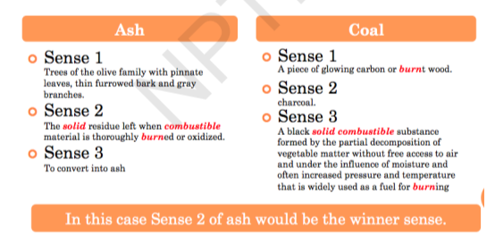
Lesk’s Algorithm
Sense Bag: contains the words in the definition of a candidate sense of the ambiguous word.
Context Bag: contains the words in the definition of each sense of each context word.
Example :-On burning coal we get ash.

Slide 9
Walker’s Algorithm
A Thesaurus Based approach
What is Thesaurus ?
A thesaurus is a book, software program, or online service that provides alternative or similar words to a word.
For example, searching for "hope" may return synonyms like "achievement," "faith," "ambition," and "optimism.“
Thesaurus vs. dictionary
A thesaurus is used to group different words with the same meaning (synonyms) and similar words.
On the other hand, a dictionary explains the definition of a word.
For example, looking up the word "computer" in a thesaurus may give words like PC, CPU, calculator, abacus, and laptop that could be used in place of the word computer.
Looking up the word "computer" in a dictionary would define the word like what is found on our computer definition.

Slide 10
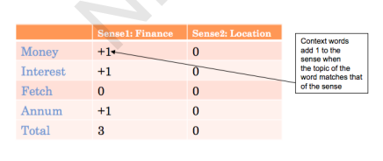
Walker’s Algorithm
A Thesaurus Based approach
Step 1: For each sense of the target word find the thesaurus category to which that sense belongs
Step 2: Calculate the score for each sense by using the context words.
A context word will add 1 to the score of the sense if the thesaurus
category of the word matches that of the sense.
E.g. The money in this bank fetches an interest of 8% per annum
Target word: bank
Clue words from the context: money, interest, annum, fetch

Slide 11
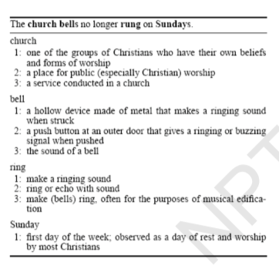
WSD Using Random Walk Algorithm

Slide 12

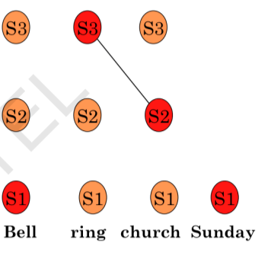

Slide 13

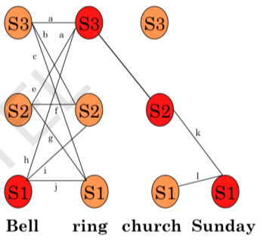

Slide 14
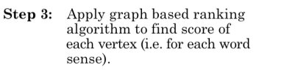
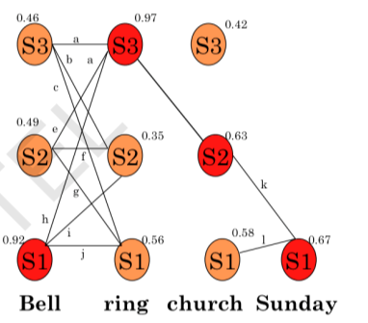
Page rank Algorithm :->

Slide 15

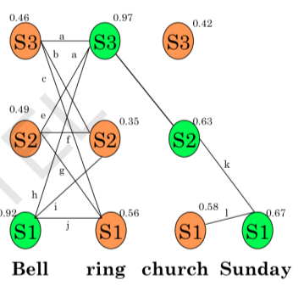

Slide 16
KB Approaches –Conclusions
Drawbacks of WSD using Selectional Restrictions
Needs exhaustive Knowledge Base.
Drawbacks of Overlap based approaches
Dictionary definitions are generally very small.
Dictionary entries rarely take into account the distributional constraints of different word senses (e.g. selectional preferences, kinds of prepositions, etc. → cigarette and ash never co-occur in a dictionary).
Suffer from the problem of sparse match.
Proper nouns are not present in a MRD. Hence these approaches fail to capture the strong clues provided by proper nouns.
E.g. “Sachin Tendulkar” will be a strong indicator of the category “sports”.
Sachin Tendulkar plays cricket.
CF
16

Slide 17
Supervised methods
Supervised methods assumes that the context can provide enough evidence on its own to disambiguate words (hence, world knowledge and reasoning are deemed unnecessary).
Probably every machine learning algorithm has been applied to WSD, including associated techniques such as feature selection, parameter optimization, and ensemble learning.
Support vector machines and memory-based learning have been shown to be the most successful approaches, to date, probably because they can cope with the high dimensionality of the feature space.
However, these supervised methods are subject to a new knowledge acquisition bottleneck since they rely on substantial amounts of manually sense tagged corpora for training, which are laborious and expensive to create.

Slide 18
Word Sense Disambiguation
Classification

Slide 19

Classification: definition
Dan Jurafsky
Input:
a word w and some features f
a fixed set of classes C = {c₁, c₂,…, c_{J}}
Output: a predicted class c∈C

Slide 20
Classification Methods: Supervised Machine
Dan Jurafsky
Learning
Input:
a word w in a text window d (which we’ll call a “document”)
a fixed set of classes C = {c₁, c₂,…, c_{J}}
A training set of m hand-‐labeled text windows again called “documents” (d₁,c₁),....,(d_{m},c_{m})
Output:
a learned classifier γ:d → c
2
2

Slide 21
Classification Methods: Supervised Machine Learning
Dan Jurafsky
Any kind of classifier
Naive Bayes
Logistic regression
Neural Networks
Support-‐vector machines
k-‐Nearest Neighbors
…

Slide 22
Applying Naive Bayes to WSD
P(c) is the prior probability of that sense
Counting in a labeled training set.
P(w|c) conditional probability of a word given a particular sense
P(w|c) = count(w,c)/count(c)
We get both of these from a tagged corpus like SemCor
Can also generalize to look at other features besides words.
Then it would be P(f|c)
Conditional probability of a feature given a sense

Slide 23
